Slide 1
Medium presentation
4 slides
2 examples

Slide 2




REDUCTION of NOISE and
VIBRATIONS in BUSES
The Industrial Problem
The firm Castrosua was interested in reducing noise inside the passengers’ cabin, and minimizing the vibrations supported by the structure of their vehicles.
Mathematical Engineering | To tackle problems relating to the simulation of devices and industrial processes, from mathematical modeling to the development of software packages.
Research group
Carrocera Castrosua | Dedicated to build bus bodies. Aims, among other things, to improve vehicle comfort and reliability.
Company

Slide 3
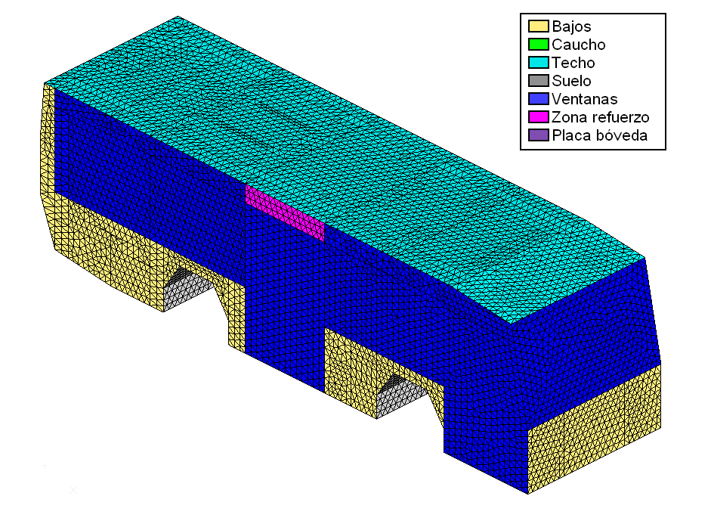
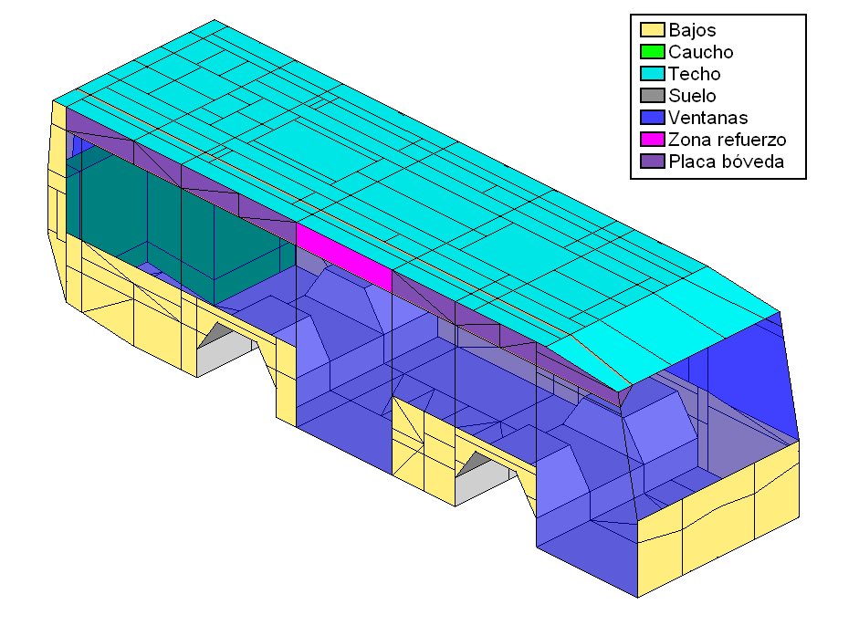
REDUCTION of NOISE and
VIBRATIONS in BUSES
Challenges & Goals
To increase the comfort and reliability of passengers in buses.
To evaluate vibro-acoustic properties in new vehicles.
To reduce noise inside the passengers' cabin.
To minimize vibrations supported by the structure of their vehicles.
To reduce costs in resources, and in time.
Geometry (left) and mesh (above) of the bus structure

Slide 4
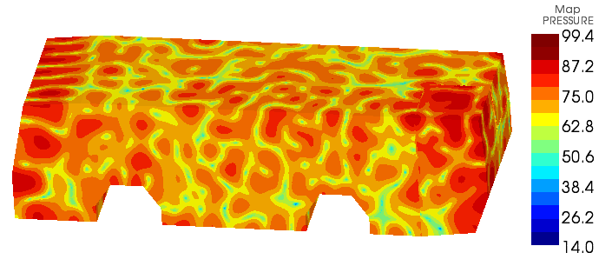
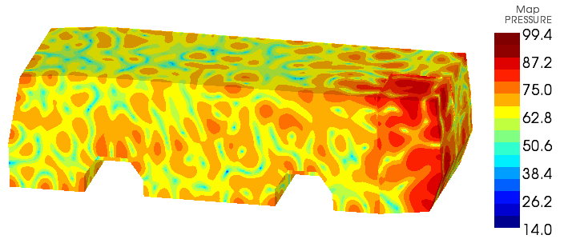
REDUCTION of NOISE and
VIBRATIONS in BUSES
Mathematical and computational methods and techniques applied
Mathematical modelling of the vehicle, both passenger cabin, and beams and plates structure.
Finite element methods to obtain an approximate solution of both the sound pressure in the passenger cabin and the displacements in the structure.
Numerical simulations aimed to assess the effectiveness of a variety of geometric configurations, different materials, etc.
Numerical simulation of the fluid pressure at a frequency of 500 Hz
Numerical simulation of the fluid pressure at a frequency of 500 Hz after applying passive coatings

Slide 5
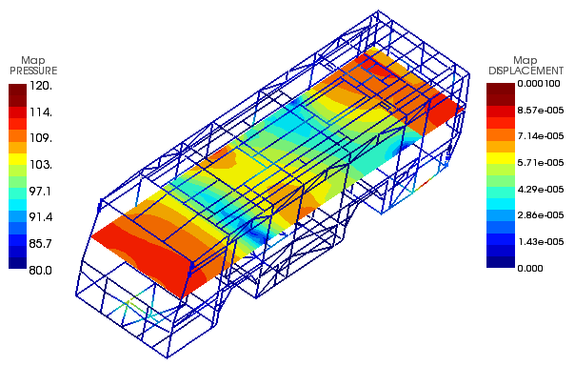




REDUCTION of NOISE and
VIBRATIONS in BUSES
Results & Benefits to the company
Different acoustic solutions based on passive coatings of absorbent materials.
Variety of geometric configurations.
A new vehicle configuration with new materials and a distribution of patches of absorbent multilayer materials.
Numerical simulation of the acoustic-structural model
The company has a calculation methodology to predict, design and optimize the acoustic behavior of their vehicles
Digital
Twin

Slide 6


PREDICTION of POLLUTION
EPISODES at a POWER PLANT
The Industrial Problem
As Pontes power plant was interested in controlling the environmental consequences of their power plant by predicting a contamination event around the power plant.
Optimization Modelling, Decision, Statistics and Applications | Statistical modelling, data analysis and optimization with software development for industrial applications and efficient resource management.
Research group
Endesa Generación | Endesa is an energy sector operator and provider of associated services, focused on electricity.
Company

Slide 7
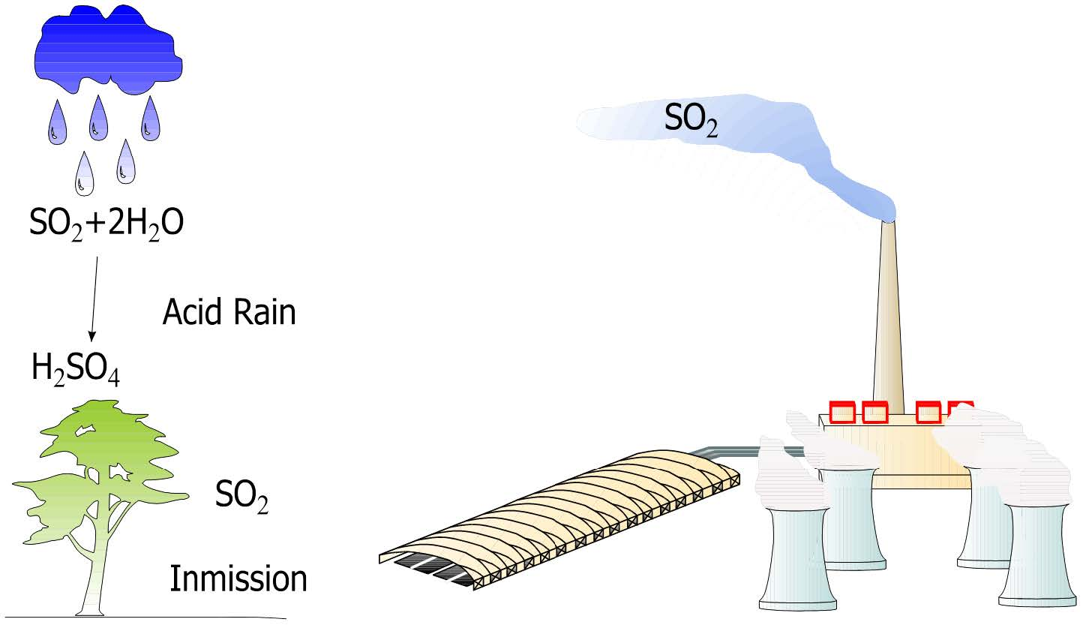
PREDICTION of POLLUTION
EPISODES at a POWER PLANT
Challenges & Goals
To prevent pollution episodes and subsequent ecological fines.
To reduce the emission of gases to the atmosphere.
To control the inmission or deposition at ground level of the chemical compounds.
To generate automatic predictions in short periods of time.
To design predictors for continuous, binary and space-like response.
Outline of the SO₂ contamination process

Slide 8
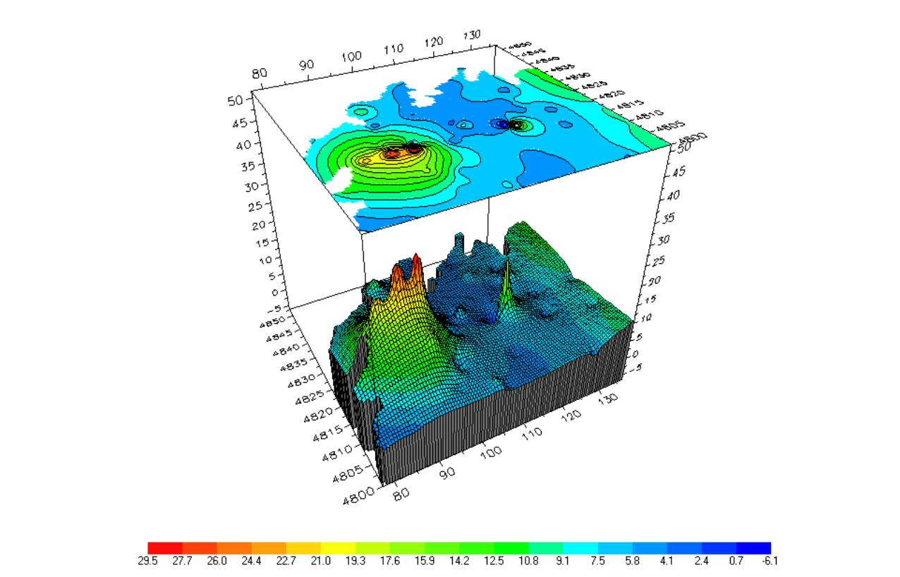
PREDICTION of POLLUTION
EPISODES at a POWER PLANT
Mathematical and computational methods and techniques applied
Methods for predicting using semiparametric time series.
Prediction methods with binary response based on generalized linear models (GLM).
Prediction methods with multidimensional response and cointegration.
Methods for predicting using spatial tecniques.
Prediction methods based on neural networks.
Prediction methods with functional data (FDA).
Spatial prediction of SO₂ concentration levels in thermal power stations

Slide 9
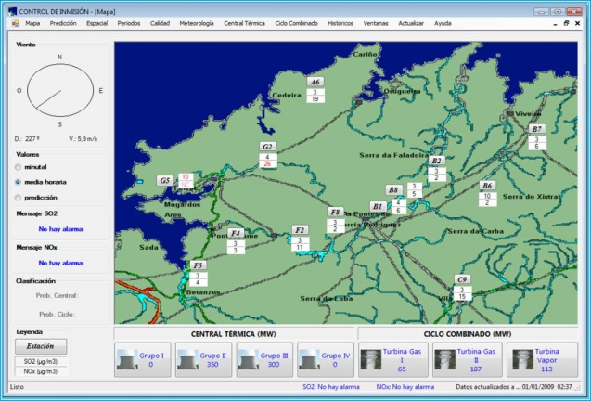
PREDICTION of POLLUTION
EPISODES at a POWER PLANT
Results & Benefits to the company
SIPEI, a developed computer program, produces predictions of gases levels half an hour before they are thrown to the environment.
25 years of a successful collaboration between the Department of Statistics and Operations Research of the University of Santiago de Compostela and As Pontes power plant on environmental modeling and control.
Staff and researchers formation: 6 thesis, more than 20 publications in high impact journals.
SIPEI, main window
The company has a computer program to predict a contamination event adapted to current legislation
Digital
Twin

